Slide 1
"Baby Care: ML-Based Fetal Health Monitoring and Prediction"

Slide 2
Introduction
The Fetus Monitoring System is an advanced healthcare solution designed to ensure the health and safety of a baby in the womb. It analyzes vital physiological parameters such as heart rate, temperature, respiratory rate, blood pressure, fetal movement, and oxygen levels to assess the baby's condition.
To achieve accurate predictions, we utilize machine learning algorithms including Gradient Boosting, Logistic Regression, Support Vector Machines (SVM), and Random Forests. After testing these models, Gradient Boosting demonstrated the highest accuracy, making it the most reliable choice for this system.
By classifying the fetus's health as either healthy or unhealthy, this system enables early detection of potential risks and supports timely medical decisions. It empowers healthcare professionals with precise insights, ensuring better prenatal care for the mother and baby.

Slide 3
Motivation and objectives
Monitoring a baby’s health during pregnancy is crucial to ensure their safety and well-being. By using predefined data, we can simplify the process of analyzing important health parameters like heart rate and movements. Machine learning allows us to predict risks quickly and accurately, making it easier for doctors to provide timely care.
The main aim of this project is to analyze predefined data to predict whether a fetus is healthy or unhealthy. By using machine learning models like Gradient Boosting, Logistic Regression, SVM, and Random Forest, we identify the best approach for accurate predictions. This system is designed to help healthcare professionals detect risks early and improve prenatal care.

Slide 4
Problem Survey
In emergencies or when doctors are unavailable, it becomes challenging to monitor the health of a baby during pregnancy. Traditional methods may not provide quick or complete information about the baby's condition. This creates a need for a system that can measure key health indicators and predict the baby's well-being accurately, helping to detect problems early and provide timely care.

Slide 5
Methodology
Data Collection
Data Preprocessing
Model Selection
Model Training
Model Evaluation
Prediction
Deployment

Slide 6
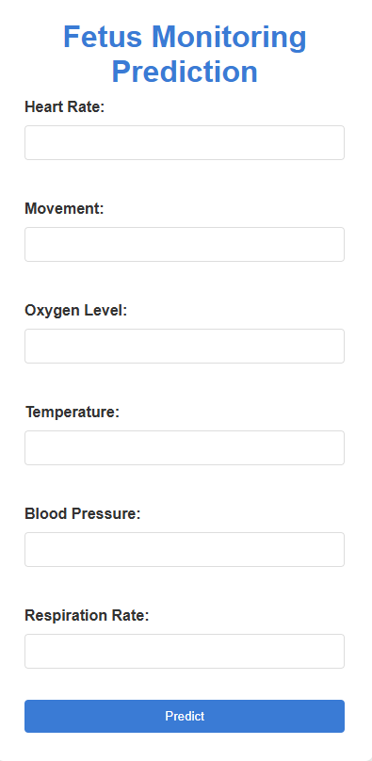
Interface
It’s user-friendly and straightforward, with fields for entering essential fetal health parameters like Heart Rate, Movement, Oxygen Level, Temperature, Blood Pressure, and Respiration Rate. After entering these values, the system uses the trained machine learning model to predict whether the baby is healthy or unhealthy, providing quick and reliable feedback.

Slide 7
Models Used
Gradient Boosting
  A powerful ensemble method that builds models sequentially, improving accuracy by correcting errors made by previous models.
Random Forest
  An ensemble algorithm that combines multiple decision trees to improve prediction accuracy and reduce overfitting.
Support Vector Machines (SVM)
  A model that finds the optimal boundary (hyperplane) to classify data by maximizing the margin between classes.
Logistic Regression
  A simple statistical model used to predict binary outcomes (e.g., healthy or unhealthy) based on input features.

